Slide 1
SNS Group(Data Analyst) Assignment
File created on: 03-09-2024 10:55:21 AM

Slide 2
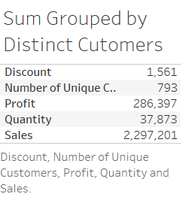

Slide 3
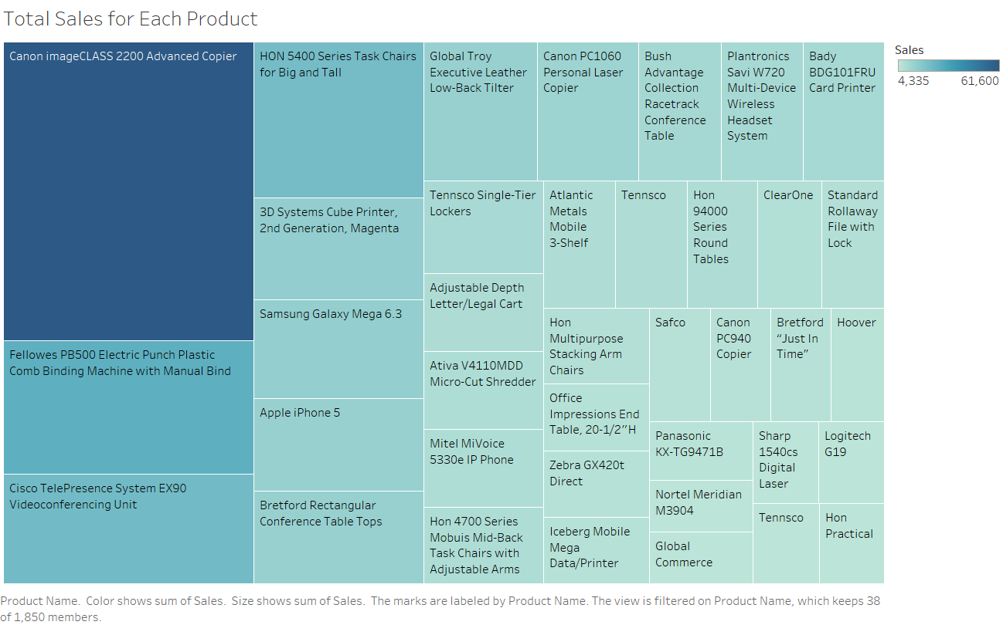

Slide 4
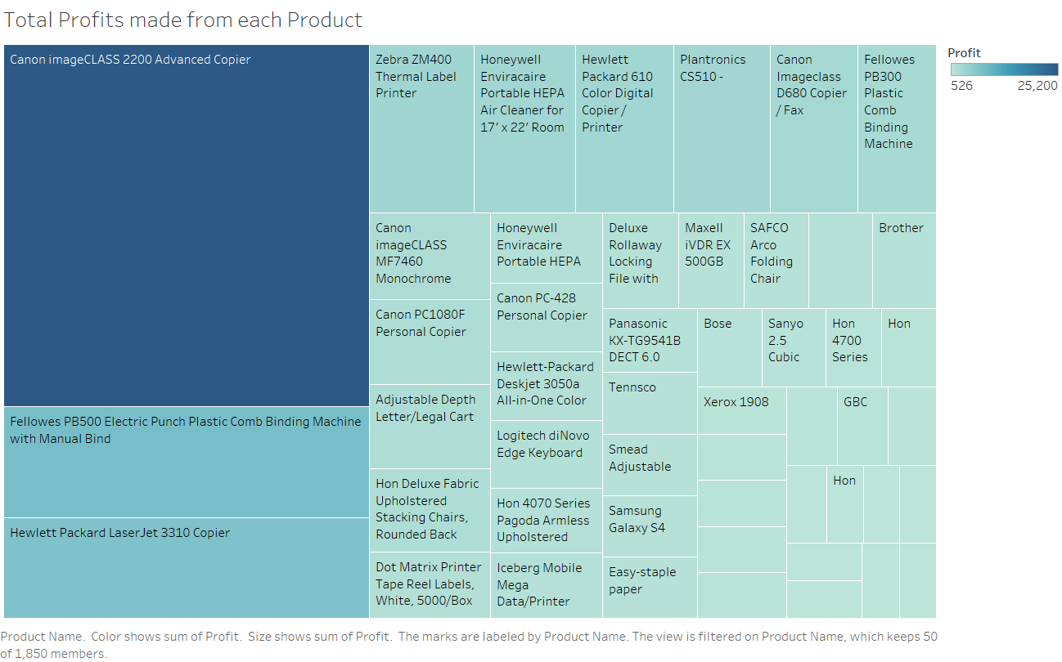

Slide 5
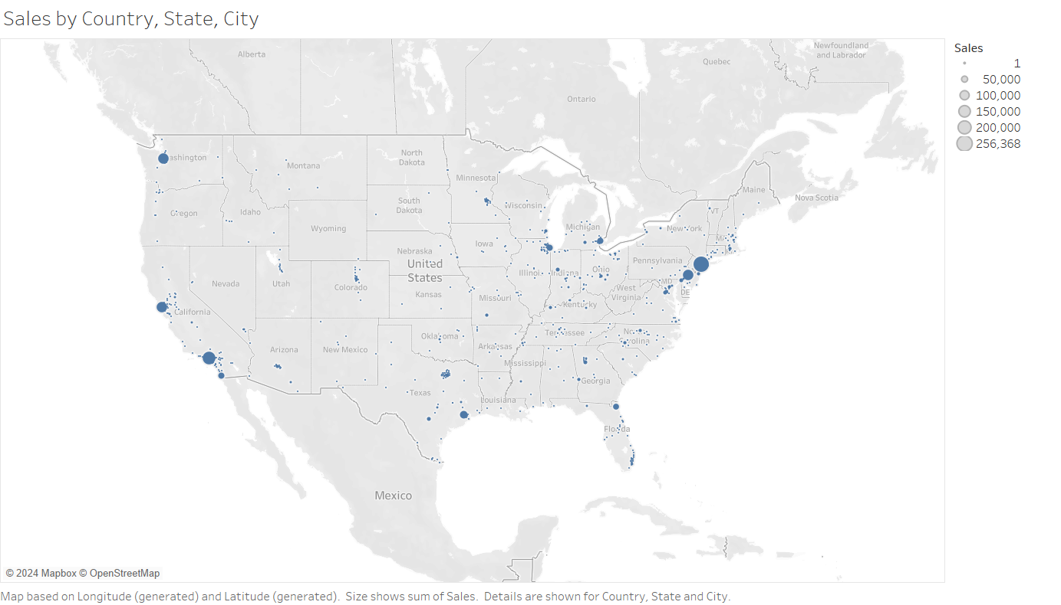

Slide 6
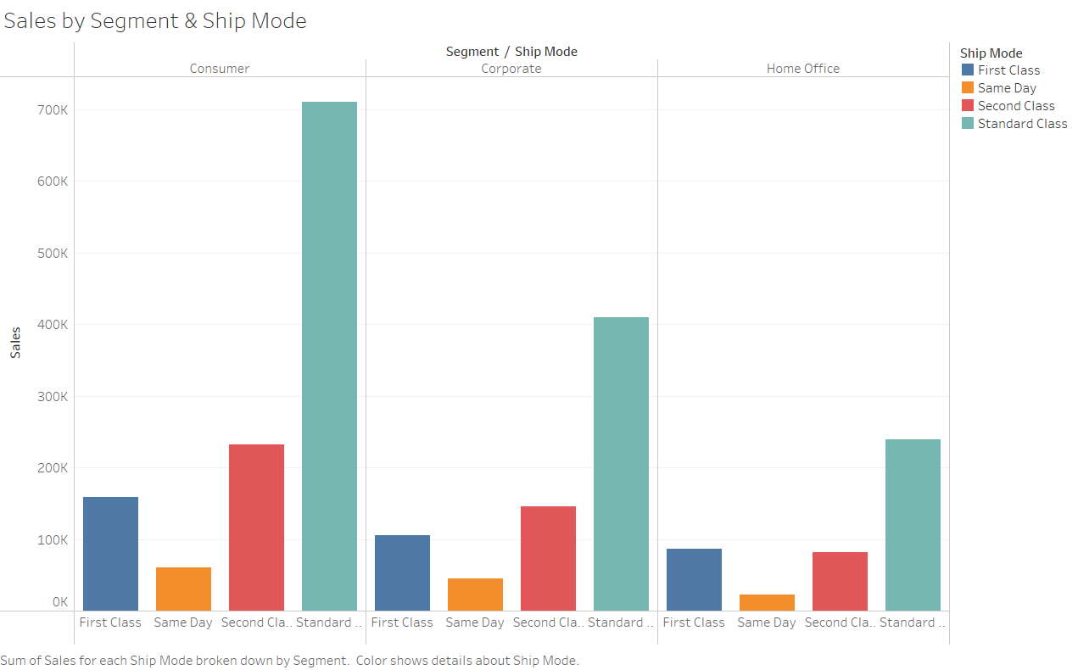

Slide 7
